Slide 1

Advanced course
Lesson 29
DIY coures（7）
Simple pedometer
YahBoom Croco:Kit tutorial

Slide 2
Advanced course
Content
Part1
Part 2
Part3
Part 4
Part 5
Learning goals
Preparation
Connection
Search for blocks
Combine blocks
YahBoom Croco:Kit tutorial

Slide 3
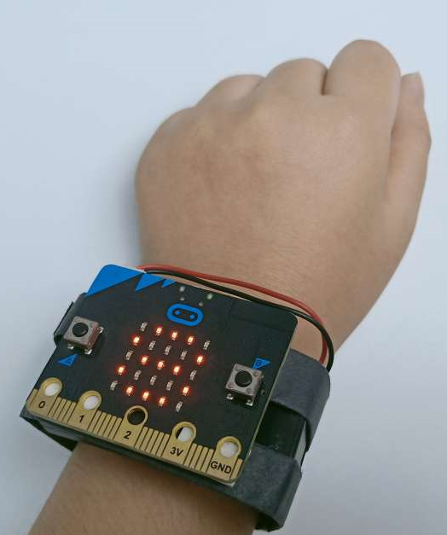
Advanced course
Part 1
Learning goals
After downloading the program, you can see the microbit LED dot matrix display ‘Hello!’, put the microbit in your hand, just lick your hand, current count will plus one.
When we press the A key to switch the display temperature, and press the A key again to switch back to the display steps.
YahBoom Croco:Kit tutorial

Slide 4
Advanced course
Part 2
Hardware:
● 1 X Micro:bit Board
● 1 X Micro USB Cable
● 2 X AAA battery
● 1 X Battery box
● 1 X Rubber band
● 1 X PC
Preparation
Mode 1 online programming: First, we need to connect the micro:bit to the computer by USB cable. The computer will pop up a USB flash drive and click on the URL in the USB flash drive: http://microbit.org/ to enter the programming interface. Add the Yahboom package: https://github.com/lzty634158/Croco-Kit to program.
Mode 2 offline programming: We need to open the offline programming software. After the installation is complete, enter the programming interface, click【New Project】, add Yahboom package: https://github.com/lzty634158/Croco-Kit , you can program.
YahBoom Croco:Kit tutorial

Slide 5
Advanced course
Part 3
Put two AAA batteries in the battery box,
Then use a rubber band to fix the micro:bit board and battery box on the your hand.
Connection
YahBoom Croco:Kit tutorial

Slide 6
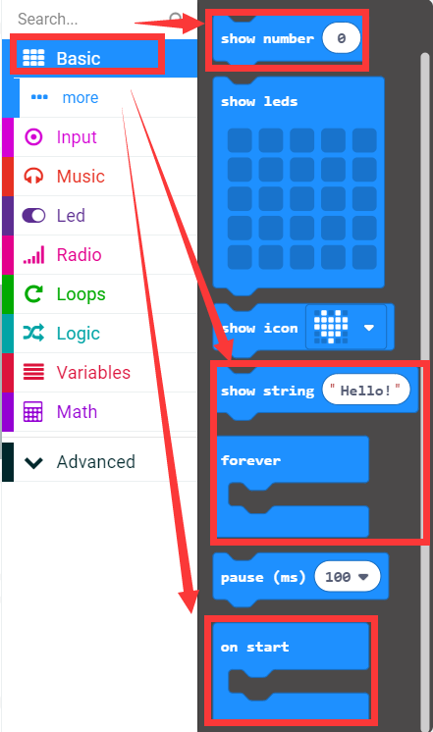
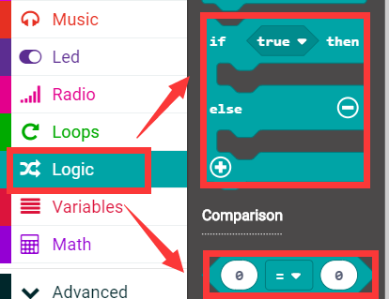
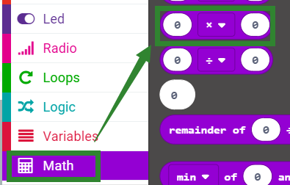
Advanced course
Part 4
Search for blocks
YahBoom Croco:Kit tutorial

Slide 7
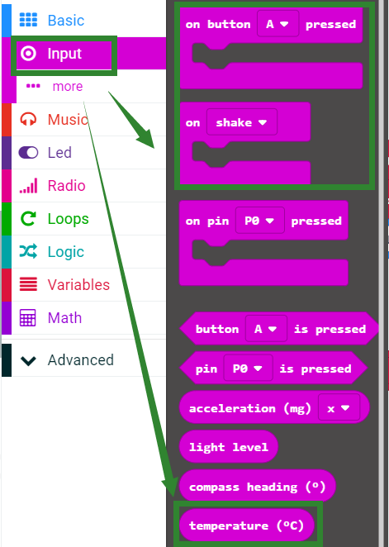
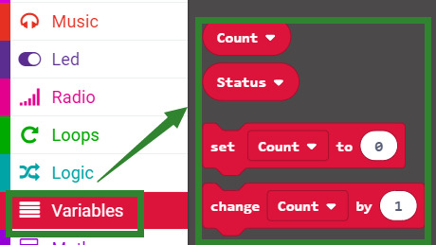
Advanced course
Part 4
Search for blocks
YahBoom Croco:Kit tutorial

Slide 8
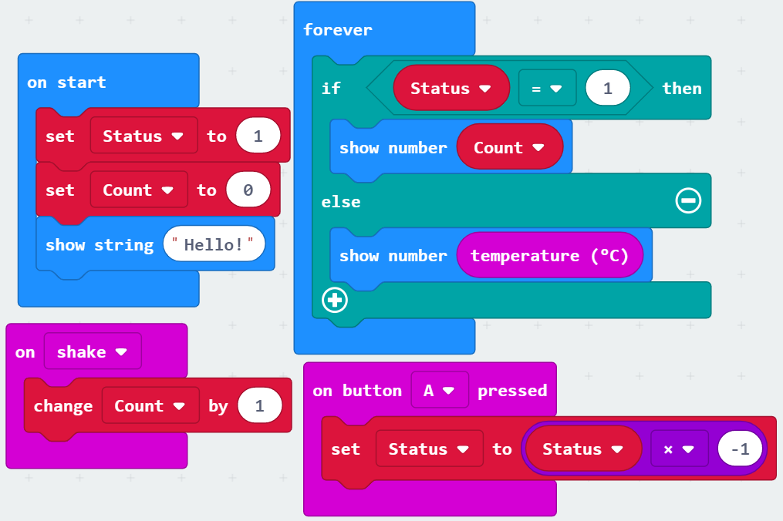
Advanced course
Part 5
Combine blocks
YahBoom Croco:Kit tutorial

Slide 9
Advanced course
Thank you ！
Powered by YahBoom
YahBoom Croco:Kit tutorial

